Slide 1

THOUGHTBUBBLE
Heuristic Evaluation Results
Overview of the Revised Design
Prototype Implementation Status

Slide 2
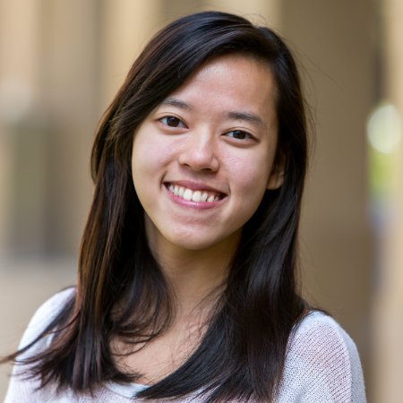

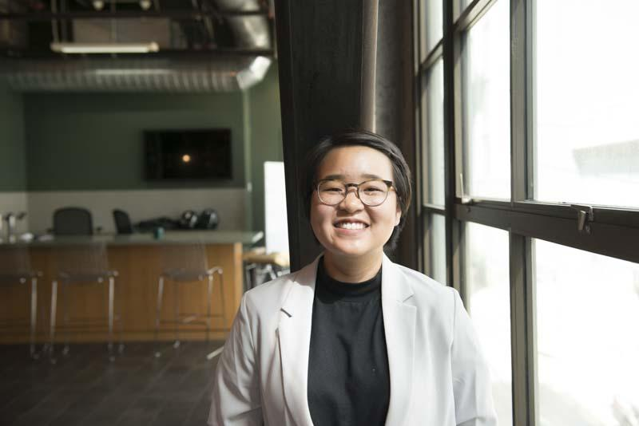
TEAM MEMBERS
Po Tsui
Bonnie Nortz
Jenny Kim
Grace Hong

Slide 3

GET HELP TALKING
ABOUT THE TOUGH QUESTIONS. EXPAND YOUR BUBBLE
VALUE PROPOSITION
PROBLEM & SOLUTION
People often find it difficult to have conversations about identity or personal experience. For the most part, they fear not knowing how to ask these questions in a sensitive manner, or worry about offending and indirectly hurting others.
We propose a solution that helps people to be forthcoming about identities and experiences they’re willing to share, guide their friends in framing tough questions, and facilitate a larger conversation across multiple identities.

Slide 4

Overview of the talk
Heuristic Evaluation Results & Overview of Revised Design
Prototype Implementation Status
Demonstration of Prototype
Conclusion

Slide 5
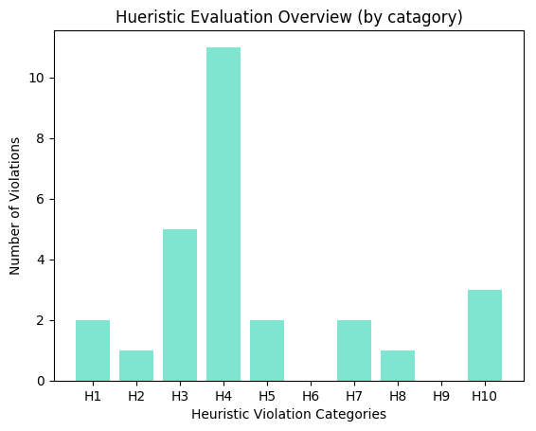
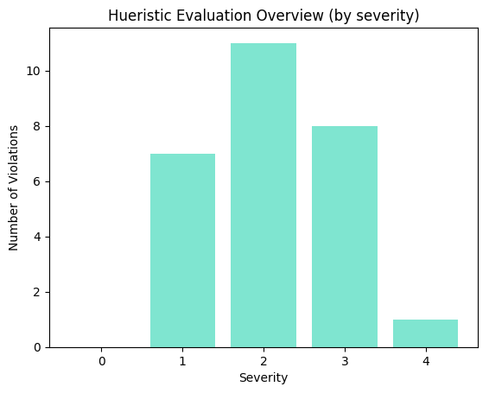
Heuristic Evaluation Result
Total Violations: 27
Number of Evaluators: 3

Slide 6
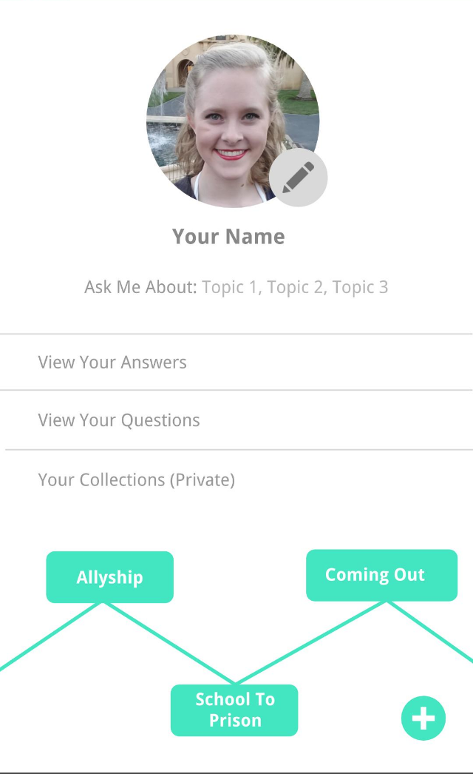
Heuristic Evaluation Result & Change
Board
Horizontally scrollable boards to navigate among different boards
The structure of the board is misleading
H4 Consistency and Standards
Severity 4
Notes:
Public profile page -> what the person asked questions - activities somewhere find friends
Bonnie ) Hidden Menu : setting, find friends
2. Board
Get rid of lines, able to scroll horizontally, board’s cutoff at the end -> one line -> list to filter thru
Get rid of the plus button -> option to save things should be when the user is saving or have a button “new board”
3. Emojis
Disney Characters -> user’s actual pictures
Text bigger in the Questions and Answers -> work on the ratio for the picture to test
4. H4 Consistency and Standards
Use Cancel in both. Next to your question, have a hyperlink “help”

Slide 7
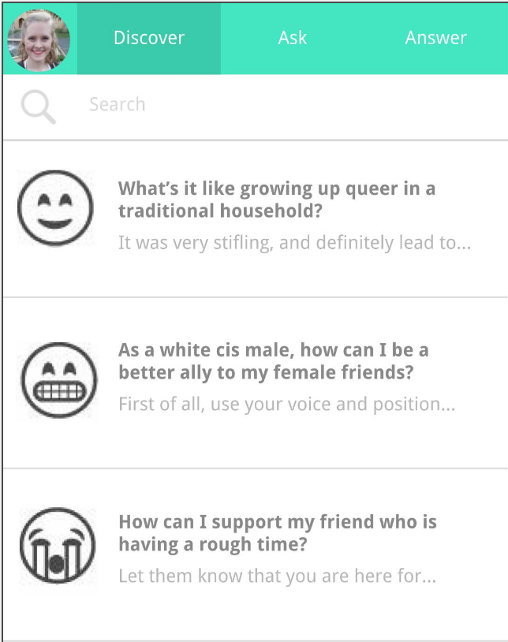
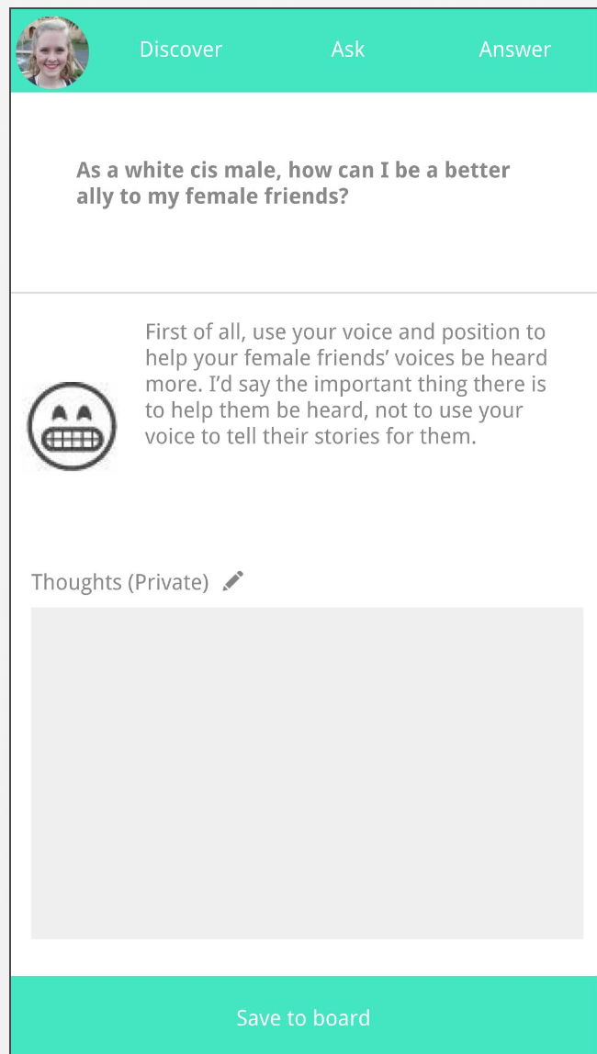
Heuristic Evaluation Result & Change
By varying the alpha value of colors on the toolbar, clearly show where the new activity was redirected from
No indication of where the question belongs to
H1 Visibility and System Status
Severity 3
Notes:
No review/revise button -> can’t revise -> vastly simplifying the answer process
Info icon, first time walk-through
27) default revise questions?

Slide 8
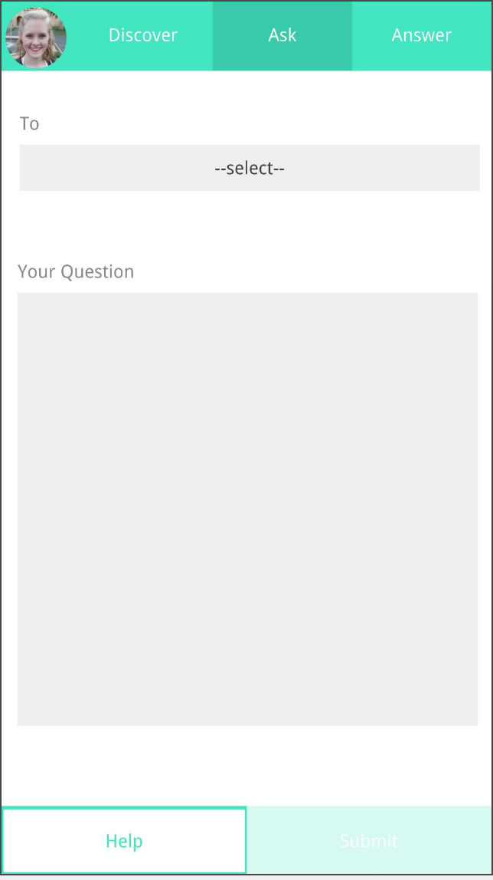
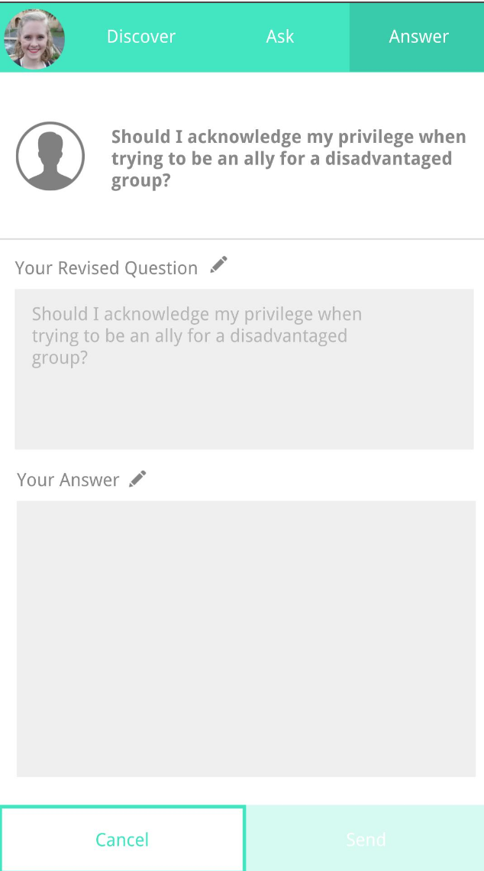
Heuristic Evaluation Result & Change
Replace the Help Button with the Cancel Button
Put Help Button next to “Your Question”
“Help” and “Cancel” buttons are in the same relative position
H4 Consistency and Standard
Severity 3
Notes:
Radio button -> change it
Edited -> anywhere u edited it
Icons next to revise and comment part

Slide 9
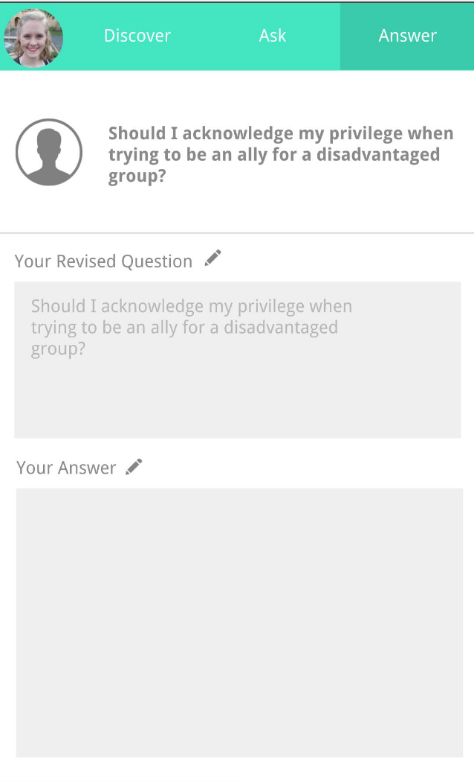
Heuristic Evaluation Result & Change
Walk the user through functionalities and motivations when they first installed the app
No explanation regarding the motivations behind revising questions
H10 Help and Documentation
Severity 3
Notes:
Radio button -> change it
Edited -> anywhere u edited it
Icons next to revise and comment part

Slide 10
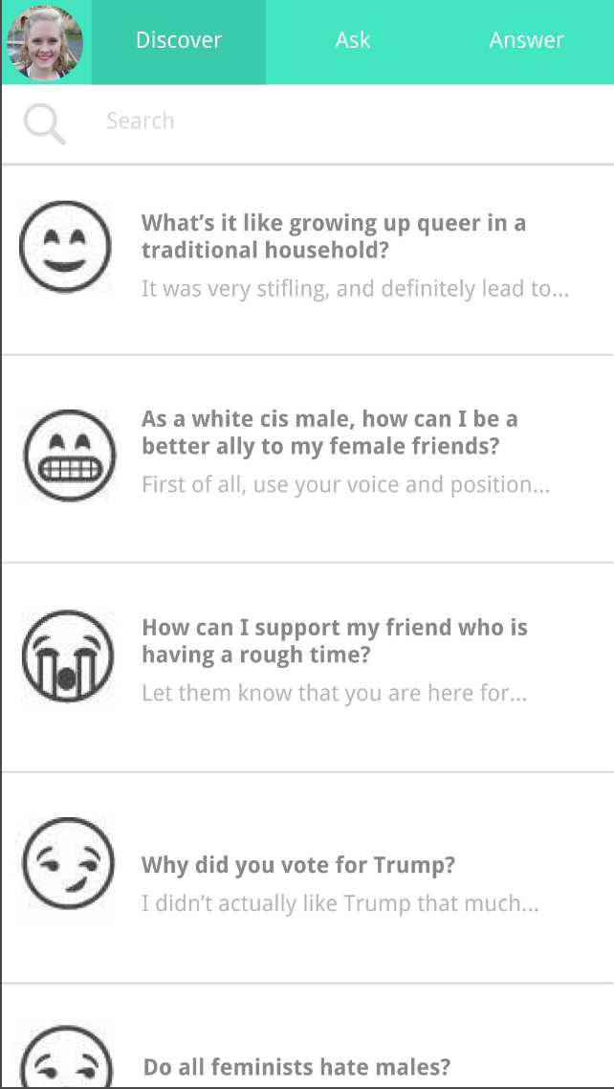
Other Notable Changes
Severity 3
H10 Help and Documentation
Feedback : What are the emojis for?
Fix : Get rid of emojis, use the profile pictures of users instead
Enlarge the font size
Let answerers revise their answers
Collapse the “Revise this question” part if the user does not want to revise the question
Let users search people and connect with them
Support both Public Profile Preview and Private Profile Edit View
Notes:
Radio button -> change it
Edited -> anywhere u edited it
Icons next to revise and comment part
Maybe trim a little bit

Slide 11



TOOLS
+
Android Studio

Slide 12

Implemented Features
Able to Navigate to All Three Different Tasks
Finished Implementing the Easy Task
“Ask Questions to Other People”
Database Saves and Retrieves the Questions asked
Profile Page (Public & Private)

Slide 13
Unimplemented Features & Plans
Finish Implementing the Medium Task
To be done by Sunday, December 3rd
Finish Implementing the Hard Task
To be done by Wednesday, December 6th
Make the prototype more beautiful
(If Time Allows) Integrate with Facebook Account
“Answer Questions”
“Reflect on Answers”

Slide 14
Wizard of Oz / Hard-Coded Data
Now : Filler Words for Spaceholding Purposes
Eventually : NONE

Slide 15
Issues / Questions
Better Board Structures?
Saving to the Board (Overlay? Fragments?)
Viewing Questions user asked?
Layout for the Profile Page (More buttons)

Slide 16
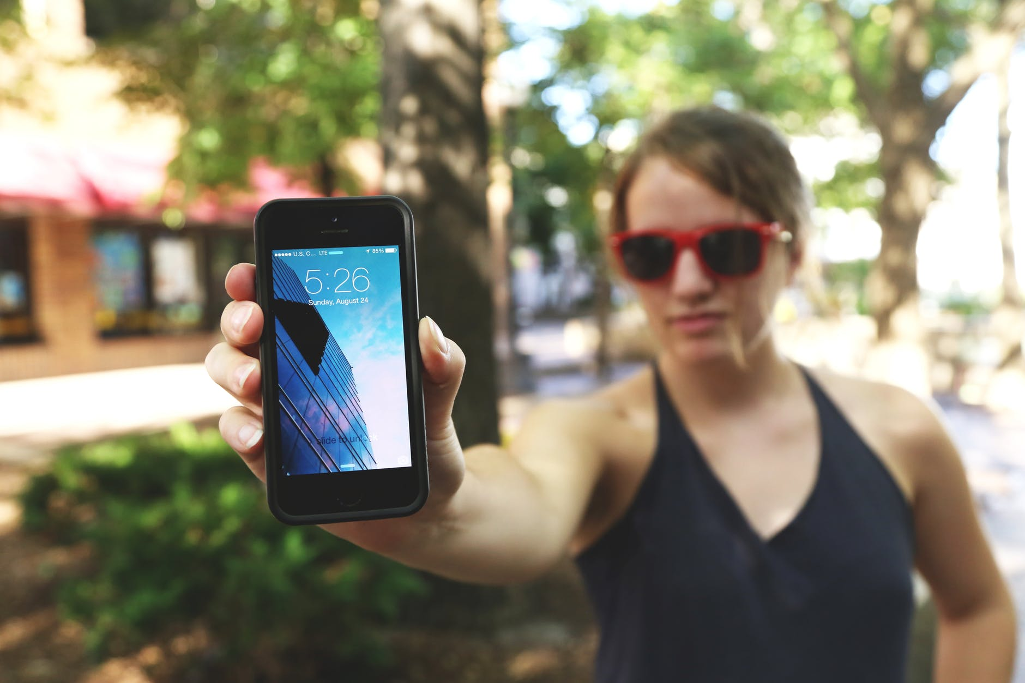
DEMO

Slide 17

CONCLUSION
Analyzed Heuristic Evaluations
Incorporated Feedbacks and Revised UI Design
Implemented Whole Flow, Intents, Profile Page, and the Ask Task
Will Be Able to Finish Implementing remaining features by next Friday, December 8th

Slide 18

QUESTIONS

